Slide 1
Principal Component Analysis (PCA)
Goal is to find a projection that captures the largest amount of variation in data

Slide 2
Why Reduce Dimensionality?
Reduces time complexity: Less computation
Reduces space complexity: Less parameters
Saves the cost of observing the feature
Simpler models are more robust on small datasets
More interpretable; simpler explanation
Data visualization (structure, groups, outliers, etc) if plotted in 2 or 3 dimensions

Slide 3

Introduction to PCA
Data reduction technique
Developed by Harold Hotelling in 1933
Purpose:
Lower dimensionality
Orthogonality of new dimensions/ transformation/ PCs
finding a mapping from the inputs in the original d-dimensional space to a new (k < d) dimensional space, with minimum loss of information.
The projection of x on the direction of w is

Slide 4
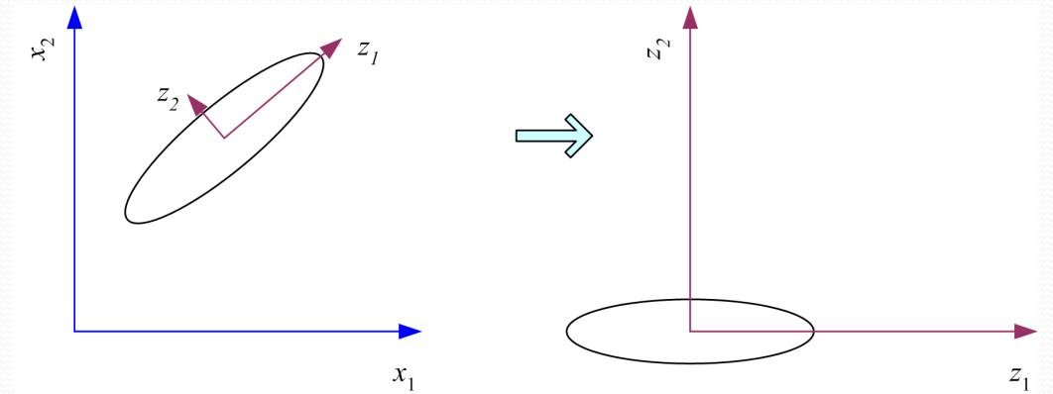
PCA
Principal components analysis centers the sample and then rotates the axes to line up with the directions of highest variance. If the variance on z2 is too small, it can be ignored and we have dimensionality reduction from two to one.
Source: Ethem Alpaydin. 2010. Introduction to Machine Learning (2nd. ed.). The MIT Press.

Slide 5
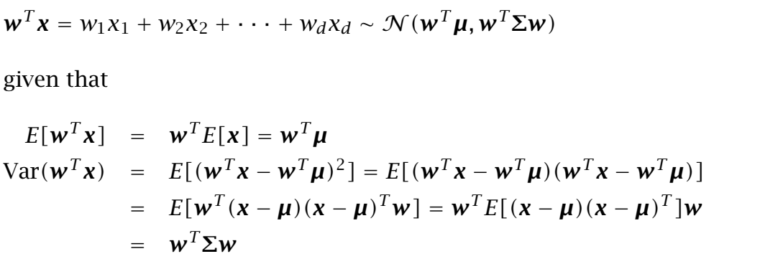
PCA (contd…)

Slide 6
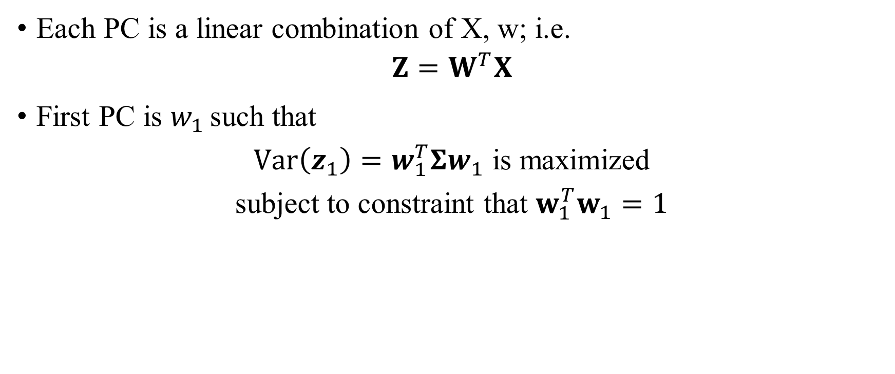

PCA (contd…)

Slide 7
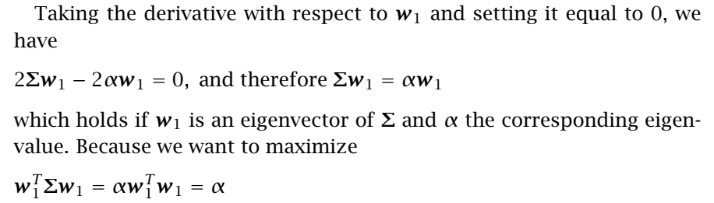
PCA (contd…)
Choose the eigenvector with the largest eigenvalue for the variance to be maximum. Therefore the principal component is the eigenvector of the covariance matrix of the input sample with the largest eigenvalue,
λ1 = α.

Slide 8
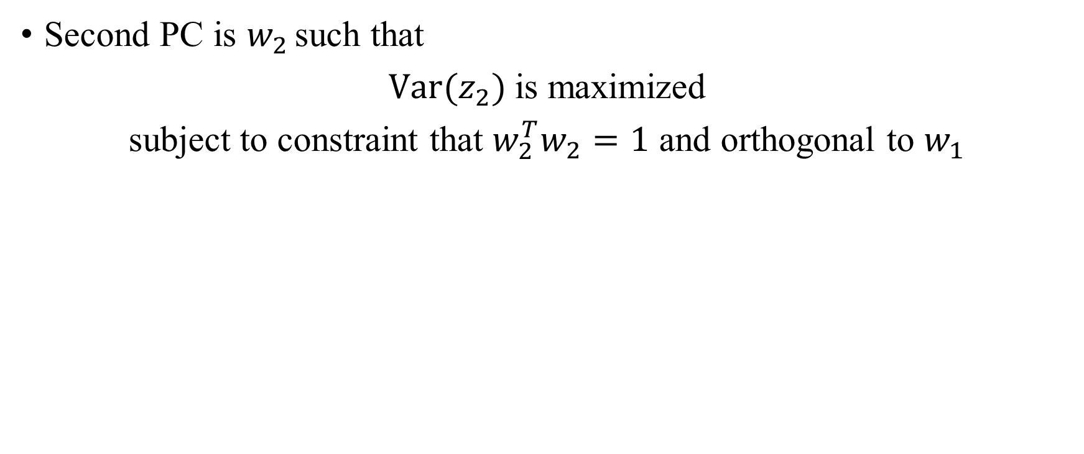

PCA (contd…)

Slide 9
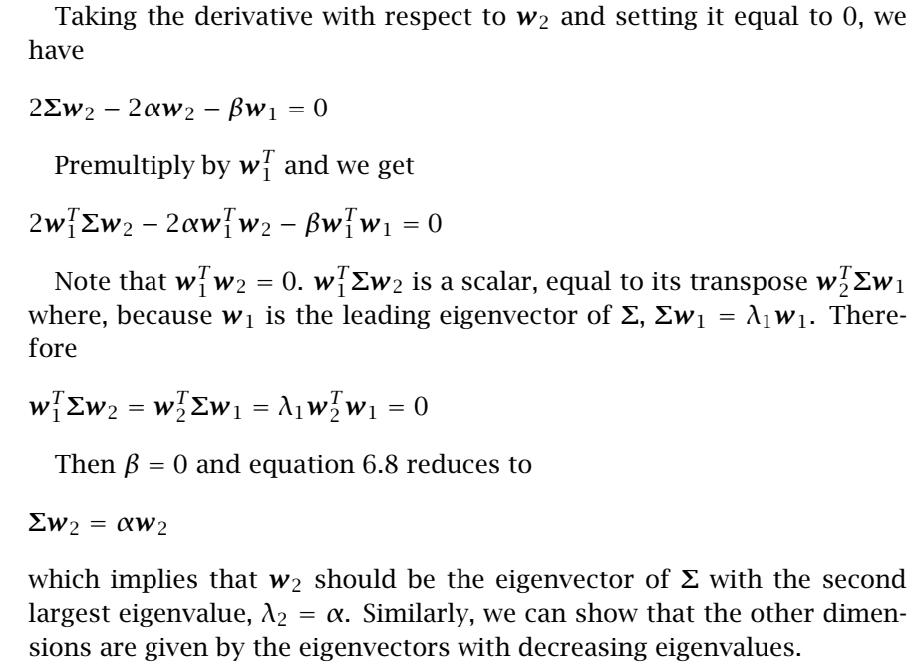
PCA (contd…)

Slide 10
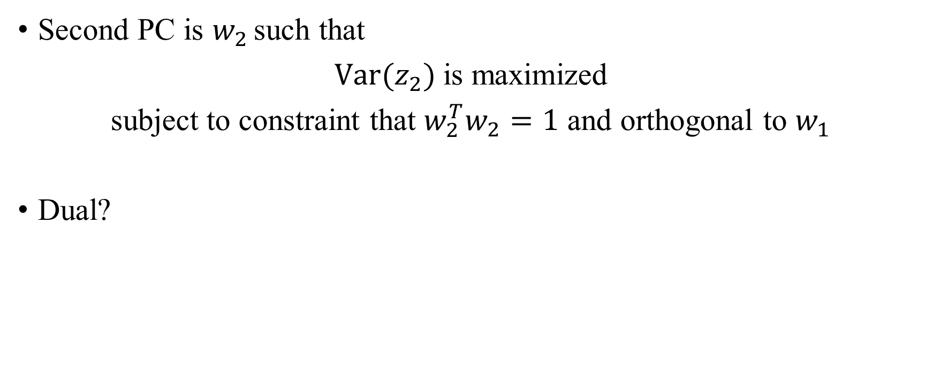
Some Points (contd…)

Slide 11
PCA (contd…)
j^{th} PC ?
Objective function?
Subject to ?

Slide 12

Some Points (contd…)
Choose ‘k’
Proportion of variance (PoV)
Scree Graph
Plot of variance explained as a function of the number of eigenvectors kept
plots of PoV vs k, stop at “elbow”
Ignore the eigenvectors whose eigenvalues are less than the average input variance

Slide 13
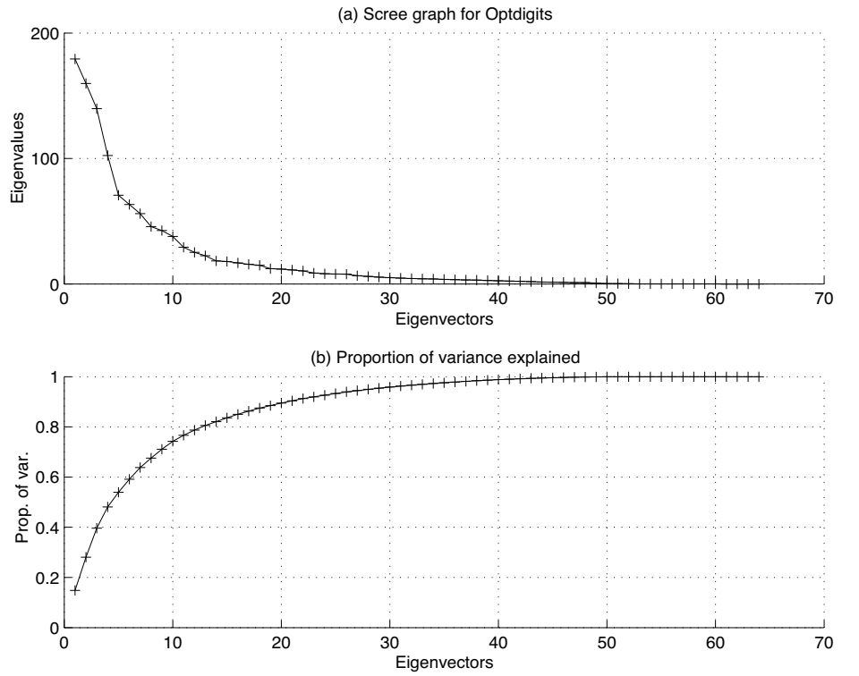
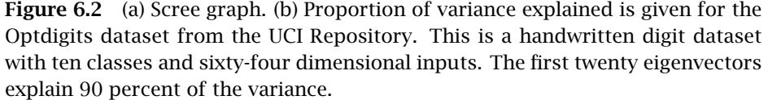
Source: Ethem Alpaydin. 2010. Introduction to Machine Learning (2nd. ed.). The MIT Press.

Slide 14
Principal Component Analysis
Step 1: Standardize the dataset.
Step 2: Calculate the covariance matrix for the features in the dataset.
Step 3: Calculate the eigenvalues and eigenvectors for the covariance matrix. Find unit eigenvector.
Step 4: Sort eigenvalues and their corresponding unit eigenvectors.
Step 5: Pick k eigenvalues and form a matrix of unit eigenvectors.
Step 6: Transform the original matrix.

Slide 15
Principal Component Analysis
Step 1: Standardize the dataset
x₁ = (2, 1), y=0
x₂ = (3, 5), y=0
x₃ = (4, 3), y=0
x₄ = (5, 6), y=1
x₅ = (6, 7), y=1
x₆ = (7, 8), y=1

Slide 16

Principal Component Analysis
Step 2: Calculate the covariance matrix for the features in the dataset.
x₁ = (2, 1), y=0
x₂ = (3, 5), y=0
x₃ = (4, 3), y=0
x₄ = (5, 6), y=1
x₅ = (6, 7), y=1
x₆ = (7, 8), y=1

Slide 17
Principal Component Analysis
Step 3: Calculate the eigenvalues and eigenvectors for the covariance matrix.
Av = λv
(A – λI)v = 0,
Here, v is known as the eigenvector belonging to each eigenvalue (λ)

Slide 18
Principal Component Analysis
Step 4: Sort eigenvalues and their corresponding eigenvectors. Find unit eigenvector.
(A – λI)v = 0,

Slide 19
Principal Component Analysis
Step 5: Pick k eigenvalues and form a matrix of eigenvectors.

Slide 20
Principal Component Analysis
Step 6: Transform the original matrix.

Slide 21


















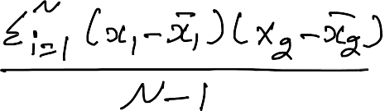



























Slide 22


































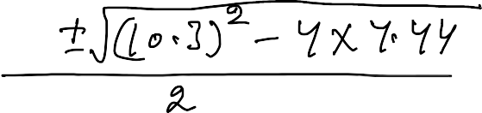







Slide 23




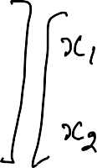






























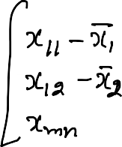









Slide 24














Slide 25
Principal Component Analysis
Is PCA good for classification problems?
NO

Slide 26
References
Ethem Alpaydin. 2010. Introduction to Machine Learning (2nd. ed.). The MIT Press.

Slide 27
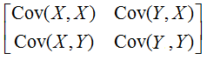

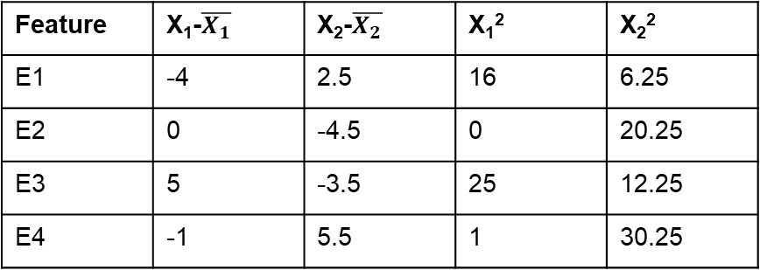


1) Dimensionality Reduction: PCA
Example1:
Step 1: Standardization (or Data normalization):
Calculate mean
$$\overline{X_{1}}=8,$$
$$\overline{X_{2}}=8.5$$
Step 2: Find Covariance matrix:
Feature | X₁ | X₂
E1 | 4 | 11
E2 | 8 | 4
E3 | 13 | 5
E4 | 7 | 14
Feature | X₁-$\overline{X_{1}}$ | X₂-$\overline{X_{2}}$ | X₁² | X₂²
E1 | -4 | 2.5 | 16 | 6.25
E2 | 0 | -4.5 | 0 | 20.25
E3 | 5 | -3.5 | 25 | 12.25
E4 | -1 | 5.5 | 1 | 30.25
(X₁ -$\overline{X_{1} }$)²/n-1(n is 4 here)=14
((X₁ -$\overline{X_{1} }$) * (X₂ -$\overline{X_{2} }$) )/n-1=-11
(X₂ -$\overline{X_{1} }$)²/n-1=23
$$\left[\begin{aligned}\begin{aligned}14 −11\end{aligned} \\ −11 23\end{aligned}\right]$$

Slide 28
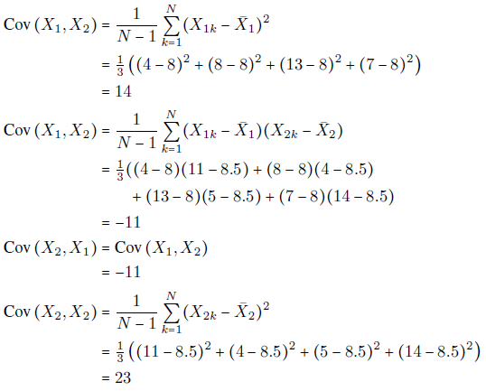

Slide 29
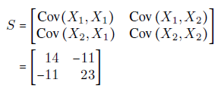
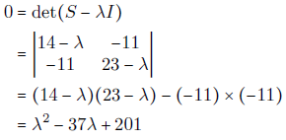

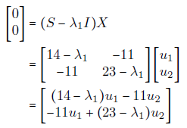

Slide 30

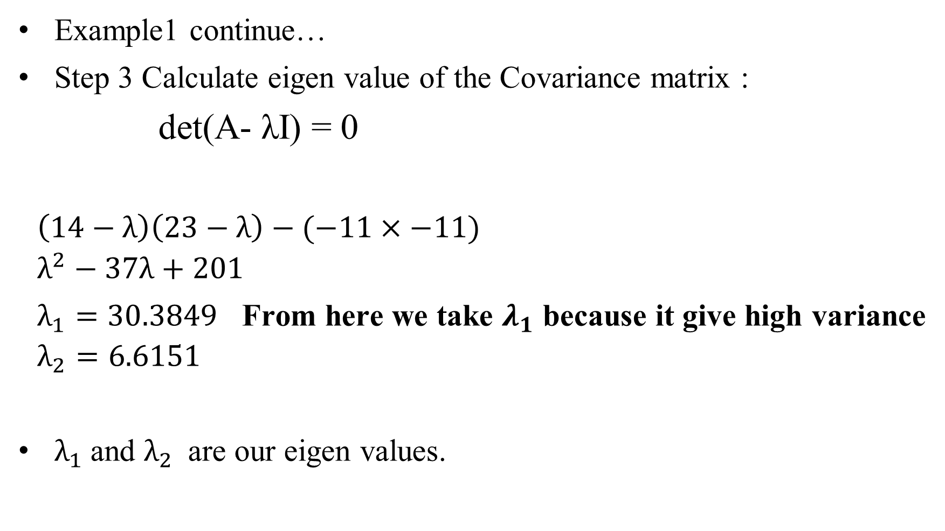
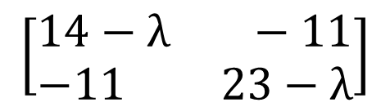
1) Dimensionality Reduction: PCA
Example1 continue…
Step 3 Calculate eigen value of the Covariance matrix :
det(A- λI) = 0
$$\left(14−λ\right)\left(23−λ\right)−(−11×−11)$$
$$λ^{2}−37λ+201$$
$λ_{1}=30.3849$ From here we take $λ_{1}$ because it give high variance
$$λ_{2}=6.6151$$
$λ_{1}$and $λ_{2}$ are our eigen values.
$$\left[\begin{aligned}\begin{aligned}14 −11\end{aligned} \\ −11 23\end{aligned}\right]$$
$$\left[\begin{aligned}\begin{aligned}14−λ −11\end{aligned} \\ −11 23−λ\end{aligned}\right]$$

Slide 31
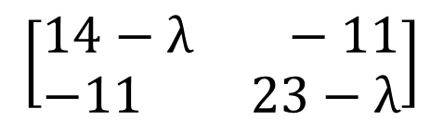
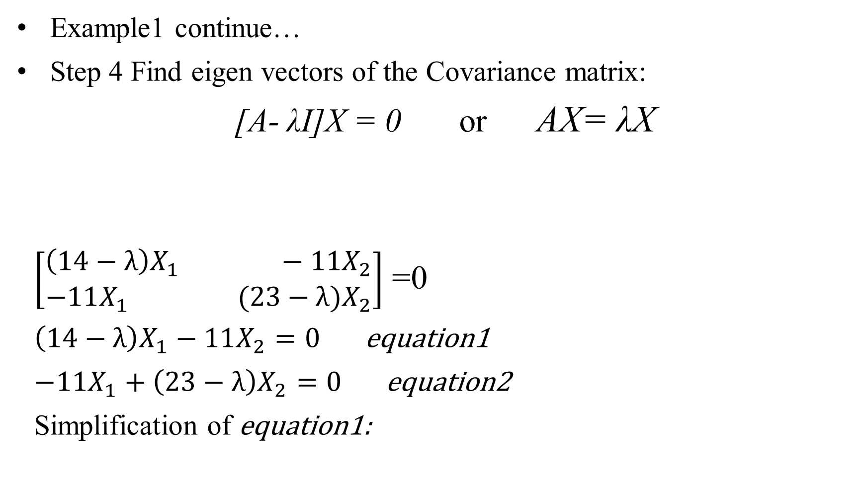
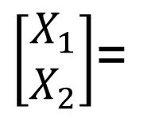

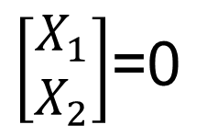
1) Dimensionality Reduction: PCA
Example1 continue…
Step 4 Find eigen vectors of the Covariance matrix:
[A- λI]X = 0 or AX= λX
$\left[\begin{aligned}\begin{aligned}\left(14−λ\right)X_{1} −11X_{2}\end{aligned} \\ −11X_{1} (23−λ)X_{2}\end{aligned}\right]$ =0
$\left(14−λ\right)X_{1}−11X_{2}=0$ equation1
$−11X_{1}+\left(23−λ\right)X_{2}=0$ equation2
Simplification of equation1:
$$\left[\begin{aligned}\begin{aligned}14−λ −11\end{aligned} \\ −11 23−λ\end{aligned}\right]$$
$\left[\begin{aligned}X_{1} \\ X_{2}\end{aligned}\right]$=0
$\left[\begin{aligned}X_{1} \\ X_{2}\end{aligned}\right]$=
$$\left[\begin{aligned}\begin{aligned}11\end{aligned} \\ 14−λ\end{aligned}\right]$$

Slide 32
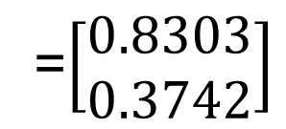



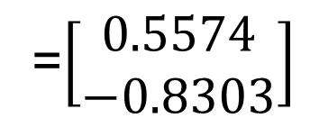

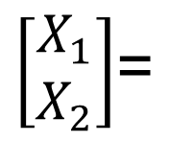

1) Dimensionality Reduction: PCA
$\left[\begin{aligned}X_{1} \\ X_{2}\end{aligned}\right]$=
$$\left[\begin{aligned}\begin{aligned}11\end{aligned} \\ 14−λ\end{aligned}\right]$$
Example1 continue…
Step 5: Find a unit (or feature) eigen vectors:
||X|| $=\sqrt{x^{2}+y^{2}+…+n^{2}}$
= $\sqrt{{11}^{2}+{(14−λ_{1})}^{2}}$
=19.7348
Here we take E₁ because we
Take $λ_{1}$ value here
$$E_{1}=\left[\begin{aligned}{11}/{19.7348} \\ {(14−λ_{1})}/{19.7348}\end{aligned}\right]$$
=$\left[\begin{aligned}0.5574 \\ −0.8303\end{aligned}\right]$
$$E_{2}=\left[\begin{aligned}{11}/{19.7348} \\ {(14−λ_{2})}/{19.7348}\end{aligned}\right]$$
=$\left[\begin{aligned}0.8303 \\ 0.3742\end{aligned}\right]$

Slide 33




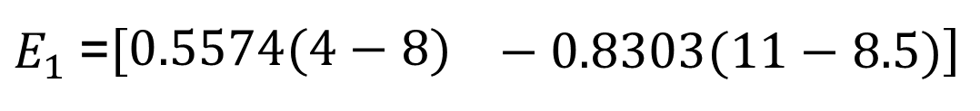
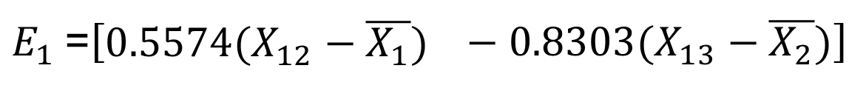
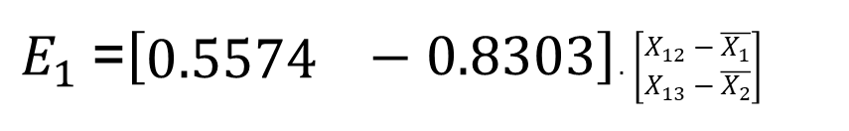

1) Dimensionality Reduction: PCA
Example1 continue…
Step 6: Find Principal components:
$E_{1}^{T}.\left[\begin{aligned}\begin{aligned}X_{12}−\overline{X_{1}} \\ X_{13}−\overline{X_{2}}\end{aligned}\end{aligned}\right]$
Feature | X₁ | X₂
E1 | 4 | 11
E2 | 8 | 4
E3 | 13 | 5
E4 | 7 | 14
$$−4.3053$$
3.73630
5.69305
-5.12405
$E_{1}$=$\left[\begin{aligned}0.5574\end{aligned} −0.8303\right]$. $\left[\begin{aligned}\begin{aligned}X_{12}−\overline{X_{1}} \\ X_{13}−\overline{X_{2}}\end{aligned}\end{aligned}\right]$
$$\overline{X_{1}}=8,$$
$$\overline{X_{2}}=8.5$$
$E_{1}$=$\left[\begin{aligned}0.5574(X_{12}−\overline{X_{1}})\end{aligned} −0.8303(X_{13}−\overline{X_{2}})\right]$
$E_{1}$=$\left[\begin{aligned}0.5574(4−8)\end{aligned} −0.8303(11−8.5)\right]$
$$=−4.3053$$
$E_{1}$=$\left[\begin{aligned}0.5574 \\ −0.8303\end{aligned}\right]$

Slide 34
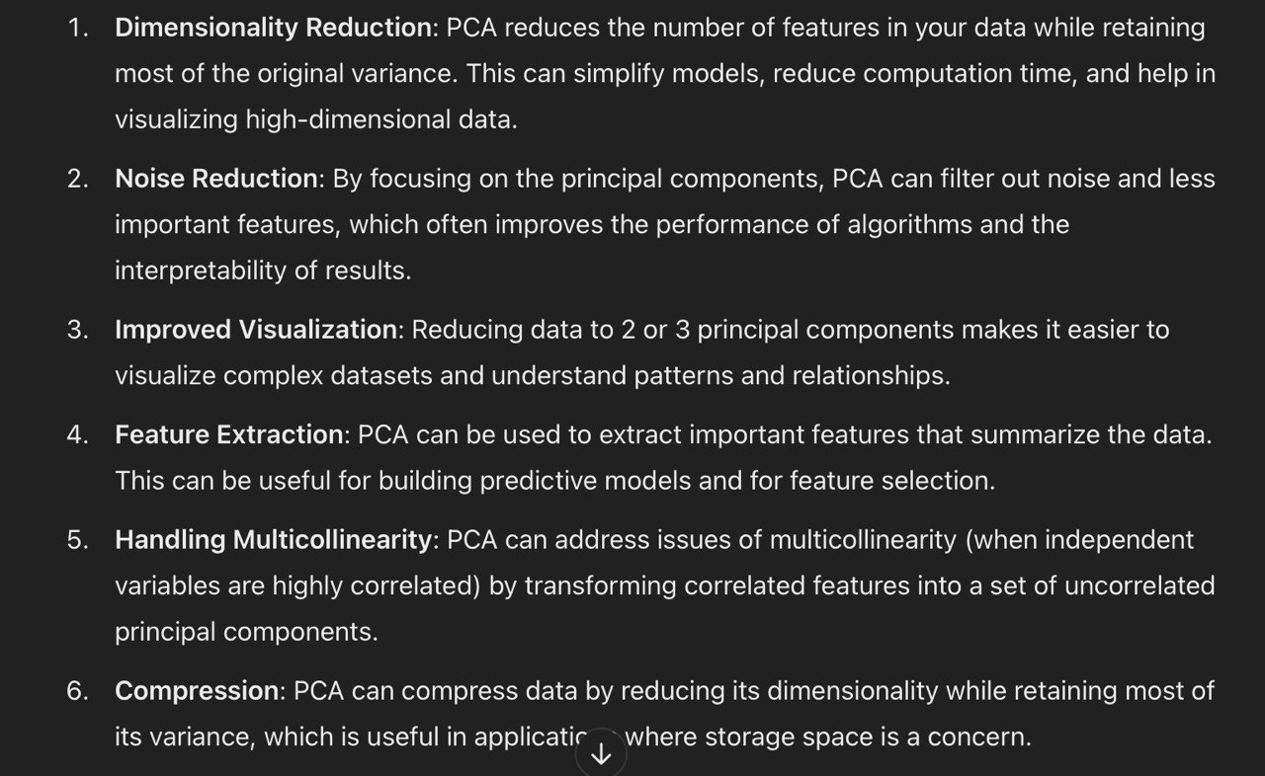

Slide 35
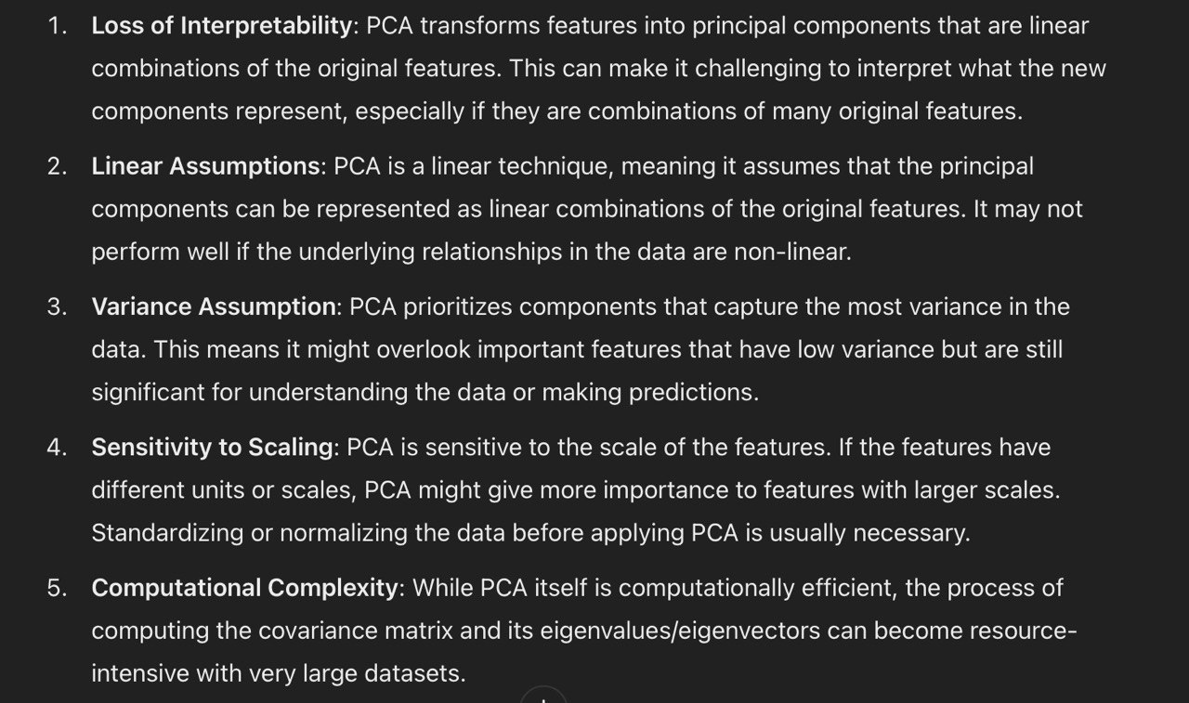

Slide 36
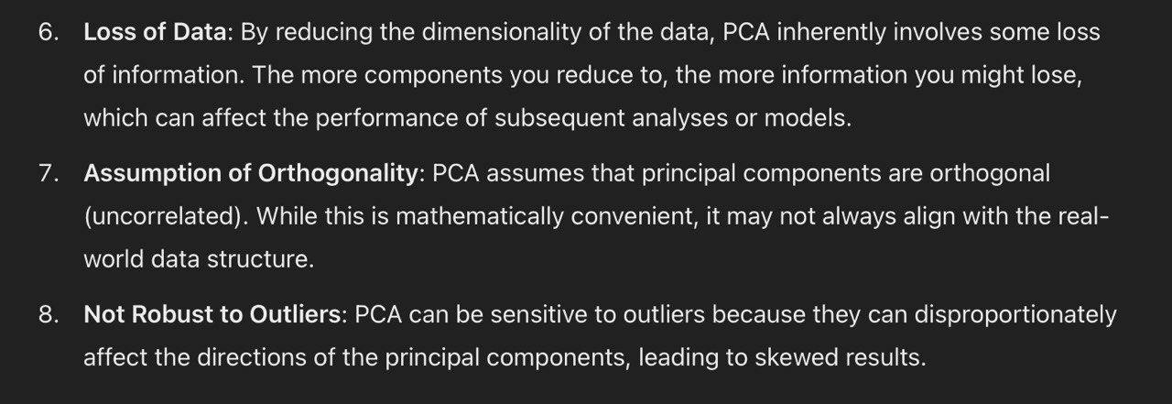

Slide 37
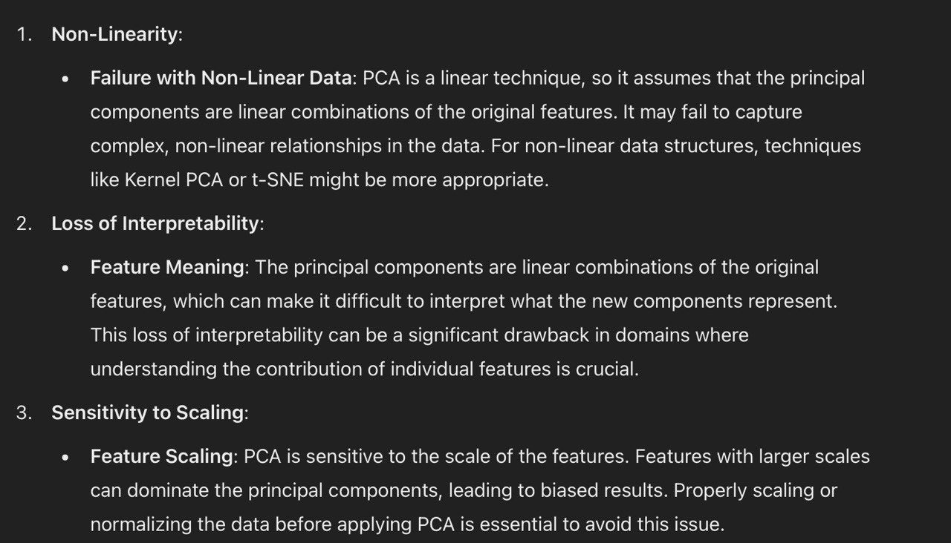

Slide 38
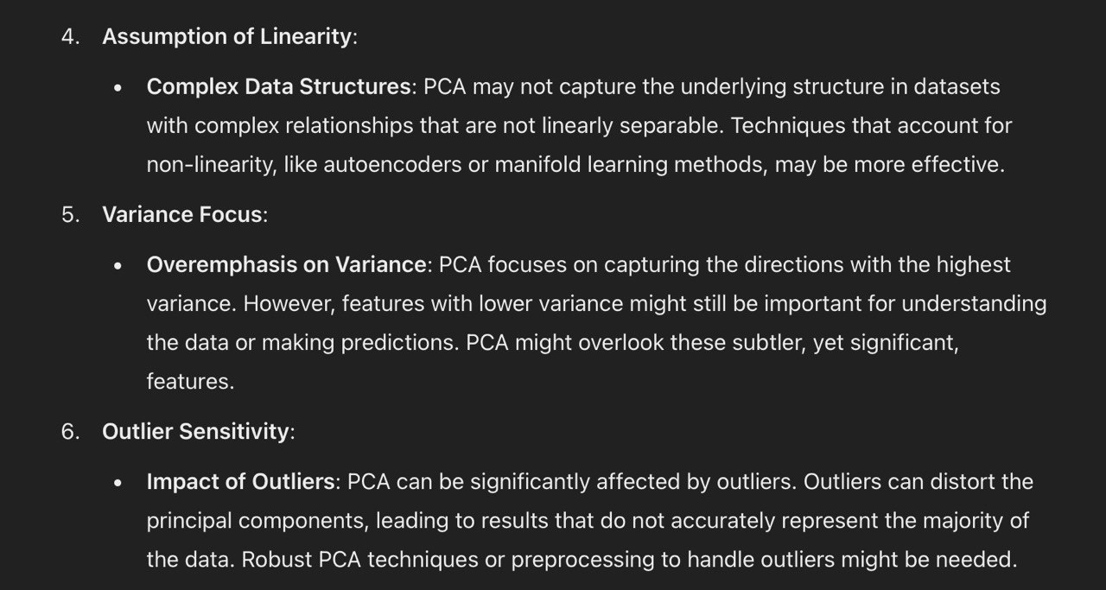

Slide 39


Slide 40
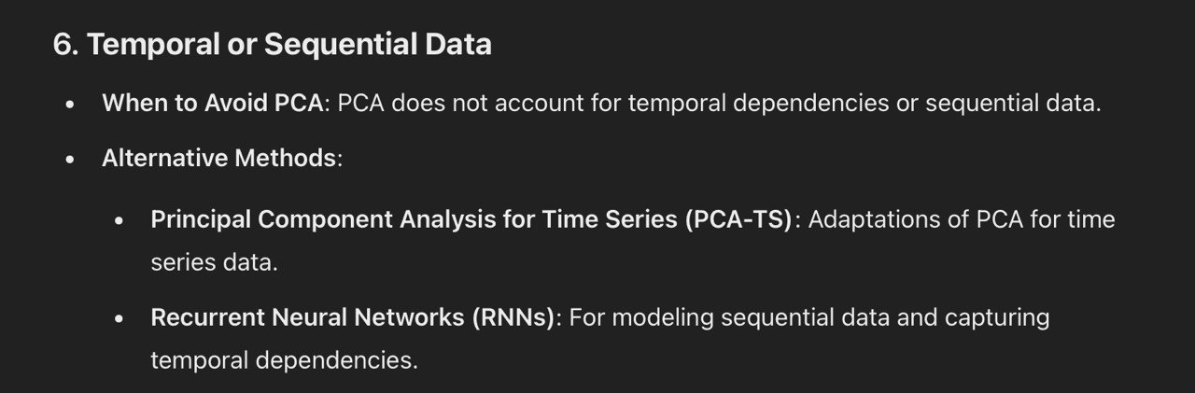

Slide 41


